Slide 1
STRATEGY PATTERN
By Michelle Johnson

Slide 2
BACKGROUND
Behavioral Pattern
Allow you to define a family of algorithms, encapsulate each one, and make them interchangeable
Strategy lets the algorithm vary independently from clients that use it

Slide 3
APPLICABILITY
Use a Strategy when related classes differ only in their behavior
Strategies provide a way to configure one class with many behaviors
Use a Strategy when you need to select an algorithm at run-time

Slide 4
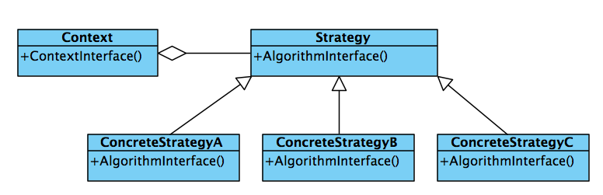
IMPLEMENTATION

Slide 5
THE FOUR PARTS
The Context provides services that is defined through by the Strategy interface and implemented by different ConcreteStrategy classes depending on the behavior.
The Strategy interface defines the behavior that is common to all the concrete implementations. The Context will invoke a specific implementation through the Strategy interface.
The ConcreteStrategy encapsulates an implementation of a specific algorithm or behavior that is defined through the Strategy interface.
The Client makes use of the Context class to invoke the different services

Slide 6
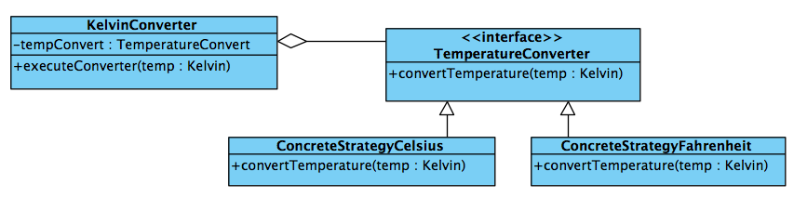
JAVA EXAMPLE:
KELVIN TEMPERATURE CONVERTER

Slide 7
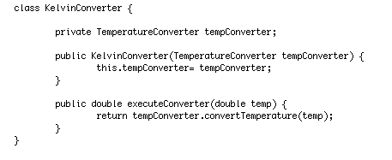

JAVA EXAMPLE:
KELVIN TEMPERATURE CONVERTER
Context: KelvinConverter
Strategy Interface: TemperatureConverter

Slide 8
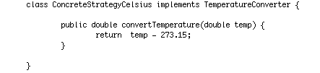

JAVA EXAMPLE:
KELVIN TEMPERATURE CONVERTER
ConcreteStrategyA: ConcreteStrategyCelsius
ConcreteStategyB: ConcreteStrategyFahrenheit

Slide 9
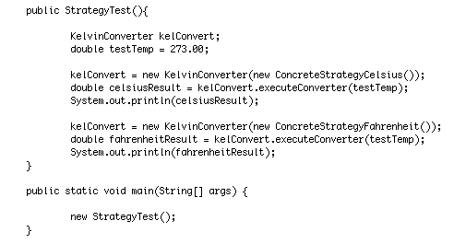
JAVA EXAMPLE:
KELVIN TEMPERATURE CONVERTER
Client: StrategyExample

Slide 10
REFERENCES
http://www.javadesign.info/DesignConcepts/DesignPatterns/GOF/strategy_pattern
http://www.cumps.be/design-patterns-strategy-pattern/
http://en.wikipedia.org/wiki/Strategy_pattern#Java

